Slide 1
SIUE Congress Overview of Activities
November 6, 2015

Slide 2
SIUE Congress
What it is:
A forum to provide SIUE with a direction and sense of purpose
A forum to explore, discuss and debate crucial issues facing the university
A forum to give faculty, staff and students a voice in our future
What it isn’t:
An official policy-making body with binding votes

Slide 3
What are the key questions?
Should SIUE continue to grow enrollment while operating with fewer state resources?
How should SIUE establish its academic program priorities?
How can SIUE increase revenues to replace the loss of state-appropriated dollars?
Should SIUE move to a different budget model and, if so, what principles should guide this model?
How can SIUE revise the curriculum and the delivery of the curriculum to improve quality and efficiency?

Slide 4
Agenda for 11/6
Opening remarks: Chancellor Hansen
Review of agenda: Tim Schoenecker/Steve Huffstutler
Q1: Should SIUE continue to grow enrollment while operating with fewer state resources?
Break
Q2: How should SIUE determine its academic program priorities
Q3: How can SIUE increase revenues to replace the loss of state-appropriated dollars? (time permitting)

Slide 5
How will this work?
For each question:
Introductory presentation with brief Q&A
Roundtable discussion of “sub-questions”
Each table should choose a scribe to record ideas on note pads
Participants determine “best” ideas
Best ideas recorded on iPad and sent to the backchannel
For each sub-question, a few tables may be asked to share their ideas with the rest of the congress

Slide 6
Backchannel Instructions
What is a back channel?
A back channel service allows all of the input entered into the iPads, from each of the tables, to be displayed on a single URL for viewing
Using a service from Todaysmeet.com

Slide 7
Backchannel Instructions
How to use the back channel?
Responses are limited to 140 characters
Will be using the iPads at each table to enter responses into the back channel
Password for all iPads is “0000” – 4 zeros
iPads automatically connected to Wi-Fi
If you have any technical issues let us know

Slide 8
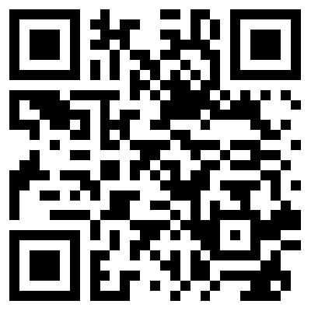
Backchannel Instructions
How to use the back channel?
Enter the back channel by:
Scanning the QR code on the table with the “QR Reader” app
Entering the URL on the table directly into Safari on the iPad
www.todaysmeet.com/SIUECongress
Enter a nickname for your table
“Table1” and click Join

Slide 9
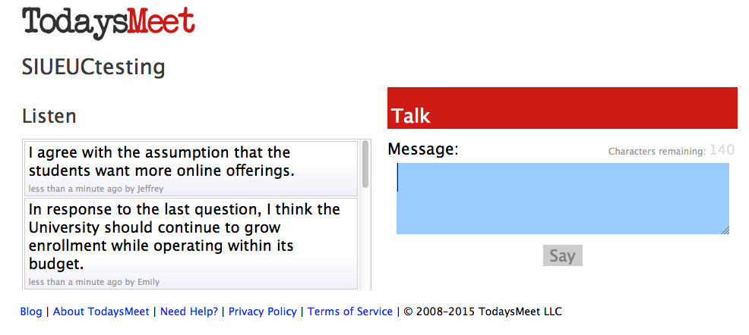
Backchannel Instructions
What is a back channel?
A back channel service allows all of the input entered into the iPads, from each of the tables, to be displayed on a single URL for viewing
Responses are limited to 140 characters
Will be using the iPads at each table to enter responses into the back channel
Password for all iPads is “0000” – 4 zeros
Enter the back channel by:

Slide 10
What happens after this session?
All backchannel information and presentation slides will be made available through a website
Chancellor and steering committee reviews feedback and identifies themes/ideas/action items
These themes will be presented back to the congress at the next session
Next session has been rescheduled to Friday, December 11 from 12:30-4:30pm
Task forces appointed to complete action items
Open forums held to allow for campus comment

